Slide 1

Ingeniería de soluciones con AI
Docente:
Francisco Macaya
Semestre 2026-1

Slide 2

LangSmith Engine: “Los agentes se ajustan solos”
Notas: https://www.langchain.com/blog/introducing-langsmith-engine
Notes:
Model distillation suggests that it’s possible to capture a large model’s behaviors using fewer parameters. Could it be that within the large model, there exists a subset of parameters capable of capturing the entire model’s behavior? This is the core concept behind pruning.
Pruning, in the context of neural networks, has two meanings. One is to remove entire nodes of a neural network, which means changing its architecture and reducing its number of parameters. Another is to find parameters least useful to predictions and set them to zero. In this case, pruning doesn’t reduce the total number of parameters, only the number of non-zero parameters. This makes the model more sparse, which both reduces the model’s storage space and speeds up computation.
Pruned models can be used as-is or be further finetuned to adjust the remaining parameters and restore any performance degradation caused by the pruning process. Pruning can help discover promising model architectures (Liu et al., 2018). These pruned architectures, smaller than the pre-pruned architectures, can also be trained from scratch (Zhu et al., 2017).
In the literature, there have been many encouraging pruning results. For example, Frankle and Carbin (2019) showed that pruning techniques can reduce the non-zero parameter counts of certain trained networks by over 90%, decreasing memory footprints and improving speed without compromising accuracy. However, in practice, as of this writing, pruning is less common. It’s harder to do, as it requires an understanding of the original model’s architecture, and the performance boost it can bring is often much less than that of other approaches. Pruning also results in sparse models, and not all hardware architectures are designed to take advantage of the resulting sparsity.
Weight-only quantization is by far the most popular approach since it’s easy to use, works out of the box for many models, and is extremely effective. Reducing a model’s precision from 32 bits to 16 bits reduces its memory footprint by half. However, we’re close to the limit of quantization—we can’t go lower than 1 bit per value. Distillation is also common because it can result in a smaller model whose behavior is comparative to that of a much larger one for your needs.

Slide 3
LangSmith Engine: ¿Cuáles son los patrones?
Trace your agent to understand what it's doing
Identify patterns in failures or gaps in functionality
Make changes to prompts, tools, logic, or structure
Ciclo de los agentes
Create ground truth datasets from production traces
Run experiments to confirm improvements and check for regressions and then ship and repeat
Notes:
Model distillation suggests that it’s possible to capture a large model’s behaviors using fewer parameters. Could it be that within the large model, there exists a subset of parameters capable of capturing the entire model’s behavior? This is the core concept behind pruning.
Pruning, in the context of neural networks, has two meanings. One is to remove entire nodes of a neural network, which means changing its architecture and reducing its number of parameters. Another is to find parameters least useful to predictions and set them to zero. In this case, pruning doesn’t reduce the total number of parameters, only the number of non-zero parameters. This makes the model more sparse, which both reduces the model’s storage space and speeds up computation.
Pruned models can be used as-is or be further finetuned to adjust the remaining parameters and restore any performance degradation caused by the pruning process. Pruning can help discover promising model architectures (Liu et al., 2018). These pruned architectures, smaller than the pre-pruned architectures, can also be trained from scratch (Zhu et al., 2017).
In the literature, there have been many encouraging pruning results. For example, Frankle and Carbin (2019) showed that pruning techniques can reduce the non-zero parameter counts of certain trained networks by over 90%, decreasing memory footprints and improving speed without compromising accuracy. However, in practice, as of this writing, pruning is less common. It’s harder to do, as it requires an understanding of the original model’s architecture, and the performance boost it can bring is often much less than that of other approaches. Pruning also results in sparse models, and not all hardware architectures are designed to take advantage of the resulting sparsity.
Weight-only quantization is by far the most popular approach since it’s easy to use, works out of the box for many models, and is extremely effective. Reducing a model’s precision from 32 bits to 16 bits reduces its memory footprint by half. However, we’re close to the limit of quantization—we can’t go lower than 1 bit per value. Distillation is also common because it can result in a smaller model whose behavior is comparative to that of a much larger one for your needs.

Slide 4
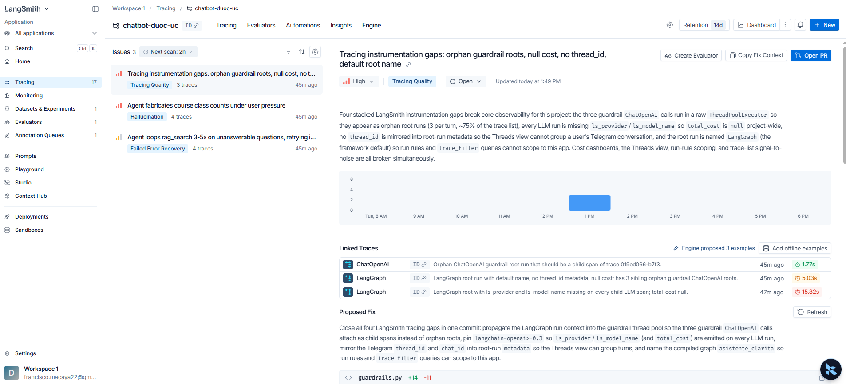
LangSmith Engine: ¿Cómo realmente luce?
Notes:
Model distillation suggests that it’s possible to capture a large model’s behaviors using fewer parameters. Could it be that within the large model, there exists a subset of parameters capable of capturing the entire model’s behavior? This is the core concept behind pruning.
Pruning, in the context of neural networks, has two meanings. One is to remove entire nodes of a neural network, which means changing its architecture and reducing its number of parameters. Another is to find parameters least useful to predictions and set them to zero. In this case, pruning doesn’t reduce the total number of parameters, only the number of non-zero parameters. This makes the model more sparse, which both reduces the model’s storage space and speeds up computation.
Pruned models can be used as-is or be further finetuned to adjust the remaining parameters and restore any performance degradation caused by the pruning process. Pruning can help discover promising model architectures (Liu et al., 2018). These pruned architectures, smaller than the pre-pruned architectures, can also be trained from scratch (Zhu et al., 2017).
In the literature, there have been many encouraging pruning results. For example, Frankle and Carbin (2019) showed that pruning techniques can reduce the non-zero parameter counts of certain trained networks by over 90%, decreasing memory footprints and improving speed without compromising accuracy. However, in practice, as of this writing, pruning is less common. It’s harder to do, as it requires an understanding of the original model’s architecture, and the performance boost it can bring is often much less than that of other approaches. Pruning also results in sparse models, and not all hardware architectures are designed to take advantage of the resulting sparsity.
Weight-only quantization is by far the most popular approach since it’s easy to use, works out of the box for many models, and is extremely effective. Reducing a model’s precision from 32 bits to 16 bits reduces its memory footprint by half. However, we’re close to the limit of quantization—we can’t go lower than 1 bit per value. Distillation is also common because it can result in a smaller model whose behavior is comparative to that of a much larger one for your needs.

Slide 5
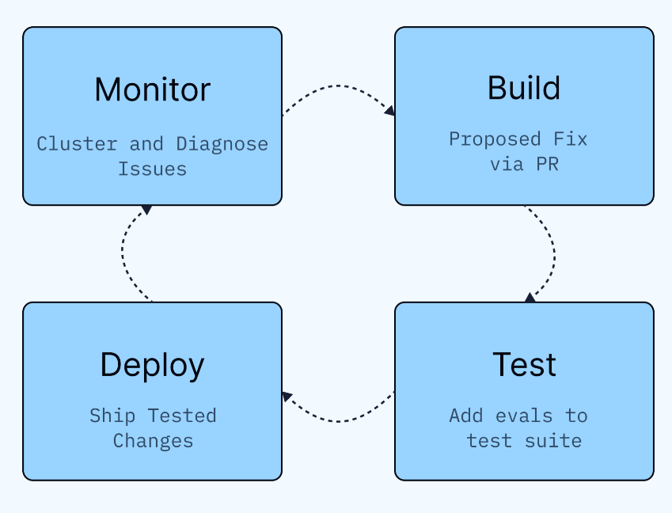
LangSmith Engine: El ciclo se cierra.
Notas: https://www.langchain.com/blog/introducing-langsmith-engine
Notes:
Model distillation suggests that it’s possible to capture a large model’s behaviors using fewer parameters. Could it be that within the large model, there exists a subset of parameters capable of capturing the entire model’s behavior? This is the core concept behind pruning.
Pruning, in the context of neural networks, has two meanings. One is to remove entire nodes of a neural network, which means changing its architecture and reducing its number of parameters. Another is to find parameters least useful to predictions and set them to zero. In this case, pruning doesn’t reduce the total number of parameters, only the number of non-zero parameters. This makes the model more sparse, which both reduces the model’s storage space and speeds up computation.
Pruned models can be used as-is or be further finetuned to adjust the remaining parameters and restore any performance degradation caused by the pruning process. Pruning can help discover promising model architectures (Liu et al., 2018). These pruned architectures, smaller than the pre-pruned architectures, can also be trained from scratch (Zhu et al., 2017).
In the literature, there have been many encouraging pruning results. For example, Frankle and Carbin (2019) showed that pruning techniques can reduce the non-zero parameter counts of certain trained networks by over 90%, decreasing memory footprints and improving speed without compromising accuracy. However, in practice, as of this writing, pruning is less common. It’s harder to do, as it requires an understanding of the original model’s architecture, and the performance boost it can bring is often much less than that of other approaches. Pruning also results in sparse models, and not all hardware architectures are designed to take advantage of the resulting sparsity.
Weight-only quantization is by far the most popular approach since it’s easy to use, works out of the box for many models, and is extremely effective. Reducing a model’s precision from 32 bits to 16 bits reduces its memory footprint by half. However, we’re close to the limit of quantization—we can’t go lower than 1 bit per value. Distillation is also common because it can result in a smaller model whose behavior is comparative to that of a much larger one for your needs.

Slide 6
Cuesta al menos 50 dólares …
¿Que realmente hay detrás de LangSmith Engine?
LangSmith Engine is powered by a deep agent that has access to your trace data, evaluator feedback, and your agent's source code (if connected to your repo).
It monitors traces for several signal types: explicit errors (tool call failures, timeouts), online evaluator failures, trace anomalies (latency spikes, token blowouts, unexpected step counts), negative user feedback, and unusual behaviors like users asking questions the agent wasn't built to answer. When Engine spots a pattern across multiple traces, it clusters them into a single named issue rather than surfacing each failure individually.
LangSmith Engine is built on top of LangSmith's existing tracing and evaluation infrastructure. It uses your existing evaluator results as inputs, so failures your evals catch feed directly into issue detection. When Engine proposes a new evaluator, it's because it detected a gap in your current coverage. When it creates a dataset example, it goes directly into your existing offline eval workflow.
Notes:
Model distillation suggests that it’s possible to capture a large model’s behaviors using fewer parameters. Could it be that within the large model, there exists a subset of parameters capable of capturing the entire model’s behavior? This is the core concept behind pruning.
Pruning, in the context of neural networks, has two meanings. One is to remove entire nodes of a neural network, which means changing its architecture and reducing its number of parameters. Another is to find parameters least useful to predictions and set them to zero. In this case, pruning doesn’t reduce the total number of parameters, only the number of non-zero parameters. This makes the model more sparse, which both reduces the model’s storage space and speeds up computation.
Pruned models can be used as-is or be further finetuned to adjust the remaining parameters and restore any performance degradation caused by the pruning process. Pruning can help discover promising model architectures (Liu et al., 2018). These pruned architectures, smaller than the pre-pruned architectures, can also be trained from scratch (Zhu et al., 2017).
In the literature, there have been many encouraging pruning results. For example, Frankle and Carbin (2019) showed that pruning techniques can reduce the non-zero parameter counts of certain trained networks by over 90%, decreasing memory footprints and improving speed without compromising accuracy. However, in practice, as of this writing, pruning is less common. It’s harder to do, as it requires an understanding of the original model’s architecture, and the performance boost it can bring is often much less than that of other approaches. Pruning also results in sparse models, and not all hardware architectures are designed to take advantage of the resulting sparsity.
Weight-only quantization is by far the most popular approach since it’s easy to use, works out of the box for many models, and is extremely effective. Reducing a model’s precision from 32 bits to 16 bits reduces its memory footprint by half. However, we’re close to the limit of quantization—we can’t go lower than 1 bit per value. Distillation is also common because it can result in a smaller model whose behavior is comparative to that of a much larger one for your needs.

Slide 7
Etapa final: Las próximas actividades del semestre.
16-06-2026: LangSmith Enginer + Avance del Proyecto
23-06-2026: Clase sobre Claude Code (Skills, MCP, SubAgentes)
30-06-2026: Sintesis del modulo.
-Presentación de la Evaluación 3 en la Plataforma.
07-07-2026: Presentación del Examen Final, donde cada grupo entre 5 a 10 minutos para su presentación.
Notes:
Model distillation suggests that it’s possible to capture a large model’s behaviors using fewer parameters. Could it be that within the large model, there exists a subset of parameters capable of capturing the entire model’s behavior? This is the core concept behind pruning.
Pruning, in the context of neural networks, has two meanings. One is to remove entire nodes of a neural network, which means changing its architecture and reducing its number of parameters. Another is to find parameters least useful to predictions and set them to zero. In this case, pruning doesn’t reduce the total number of parameters, only the number of non-zero parameters. This makes the model more sparse, which both reduces the model’s storage space and speeds up computation.
Pruned models can be used as-is or be further finetuned to adjust the remaining parameters and restore any performance degradation caused by the pruning process. Pruning can help discover promising model architectures (Liu et al., 2018). These pruned architectures, smaller than the pre-pruned architectures, can also be trained from scratch (Zhu et al., 2017).
In the literature, there have been many encouraging pruning results. For example, Frankle and Carbin (2019) showed that pruning techniques can reduce the non-zero parameter counts of certain trained networks by over 90%, decreasing memory footprints and improving speed without compromising accuracy. However, in practice, as of this writing, pruning is less common. It’s harder to do, as it requires an understanding of the original model’s architecture, and the performance boost it can bring is often much less than that of other approaches. Pruning also results in sparse models, and not all hardware architectures are designed to take advantage of the resulting sparsity.
Weight-only quantization is by far the most popular approach since it’s easy to use, works out of the box for many models, and is extremely effective. Reducing a model’s precision from 32 bits to 16 bits reduces its memory footprint by half. However, we’re close to the limit of quantization—we can’t go lower than 1 bit per value. Distillation is also common because it can result in a smaller model whose behavior is comparative to that of a much larger one for your needs.

